Slide 1
Customer Segmentation
-RMF & K-Means clustering
Team Details:
Sashank Padmanabhuni
Manvit C V
Sudarshan Jadhav
Jahanvi Virani
Aishwarya Nandini
Mukesh Pragada

Slide 2
Problem Definition:
In the area of retail, understanding customer behavior is the Mainspring of success.
Identifying distinct groups of customers, each with unique preferences and buying habit plays a key role in the success of the business. This is where the power of customer segmentation comes into play.
Customer segmentation is a process of dividing all customers into distinct groups that share similar characteristics, such as demographics, interests, patterns, or location, and can help a business focus marketing efforts and resources on valuable, loyal customers to achieve business goals.
This segmentation can be performed with customers’ demographic, geographic, behavioral, psychological data and Clustering model.

Slide 3
About the data:
This Online Retail II data set contains all the transactions occurring for a UK-based and registered, non-store online retail between 01/12/2009 and 09/12/2011.The company mainly sells unique allocation gift-ware. Many customers of the company are wholesalers.

Slide 4
Attribute description:
Invoice No: Nominal. A 6-digit integral number uniquely assigned to each transaction. If the code begins with 'c', it in dictates a cancellation.
Stock Code: Nominal. A 5-digit integral number uniquely assigned to each distinct product (item).
Description: Nominal. The name of the product (item).
Quantity: Numeric. The quantities of each product (item) per transaction.
Invoice Date: Numeric. The date and time when a transaction was generated.
Price: Numeric. The unit price of the product per unit in sterling (£).
Customer ID: Nominal. A 5-digit integral number uniquely assigned to each customer.
Country: Nominal. The name of the country where a customer resides.

Slide 5
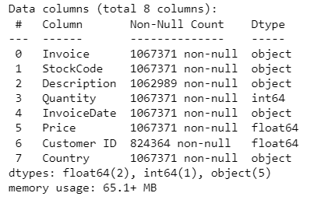
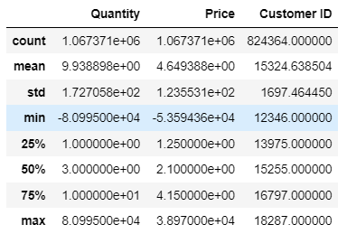
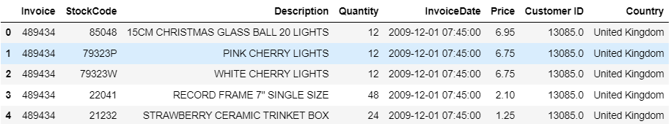

General information of the dataset:

Slide 6
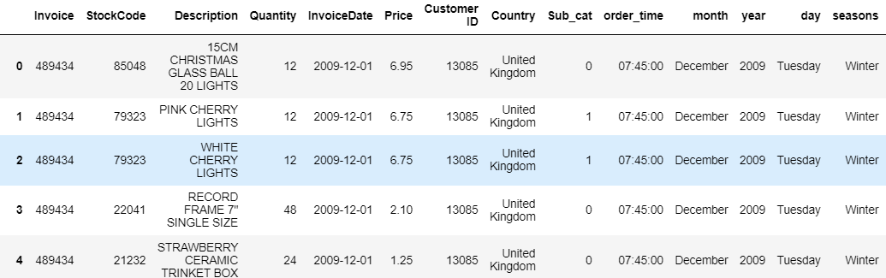
Data Preparation:
Treating the anomalies in the StockCode & Invoice column.
Removing negative values in column quantity and price.
There was 87.9% missing value in Stock_subcat. Instead of deleting the column, we'll create a new column where we'll mark 1 if there is a subcategory for the product, 0 if not. Now we can drop our old sub category column. 22.5% missing value in Customer ID. Removed the records without Customer ID, considering the size of the data.
Feature engineering: Created various periodic columns from InvoiceDate column to study the behavior of purchase
Treating Outliers.
After feature engineering and now we are with 802632 rows and 17 columns.

Slide 7
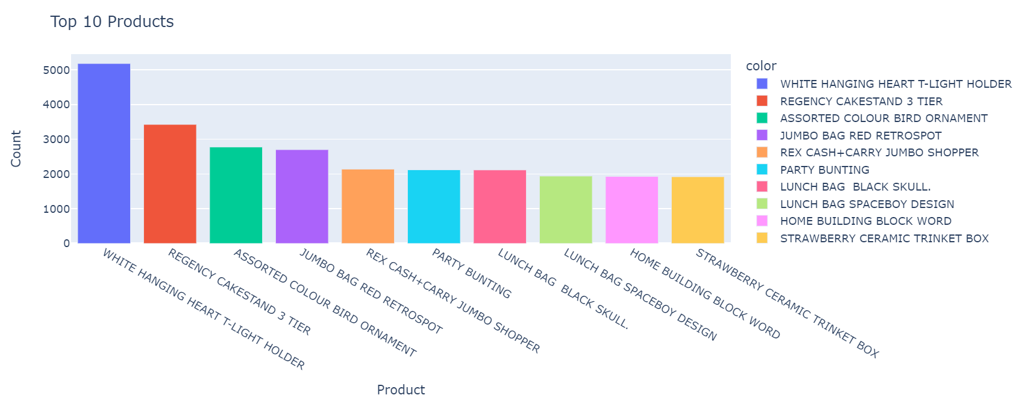
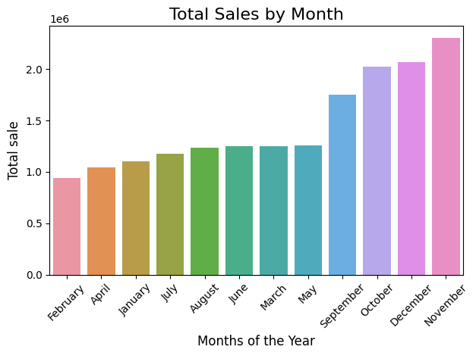
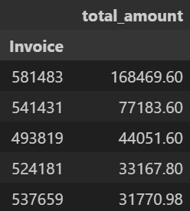
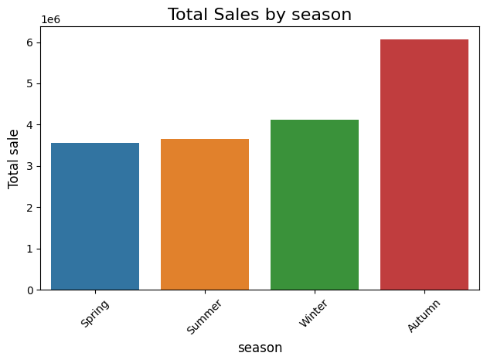
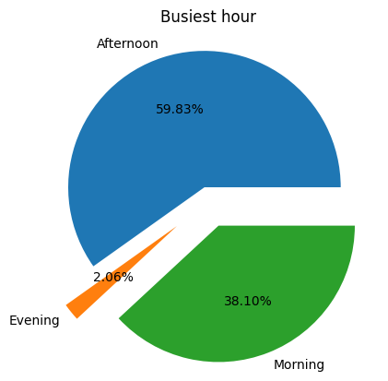
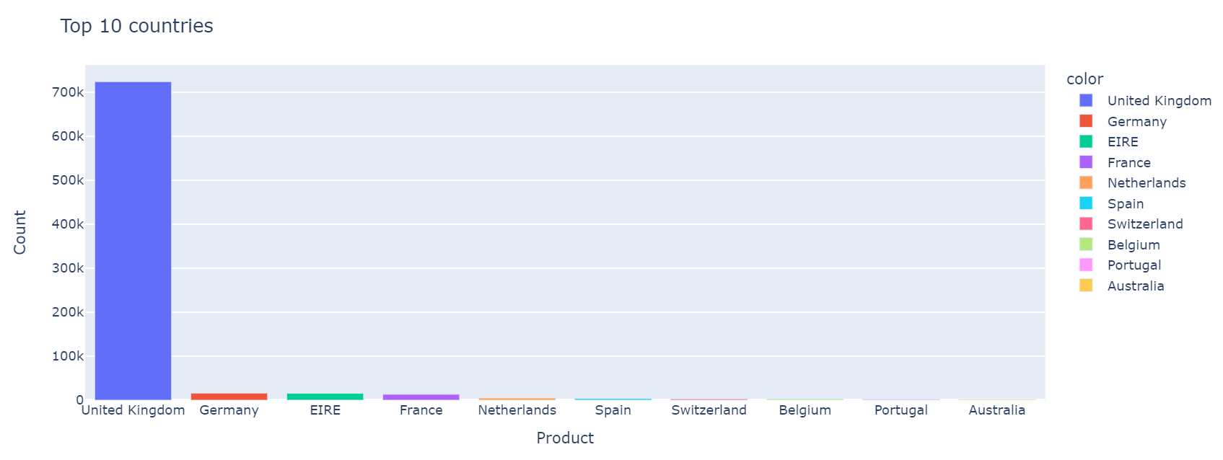
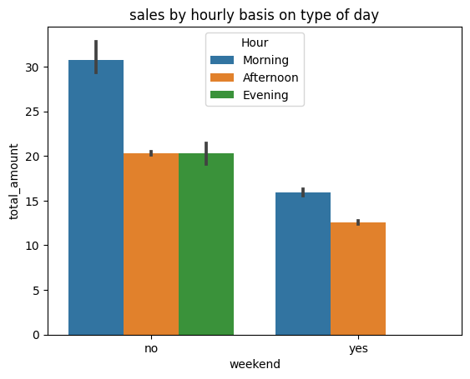
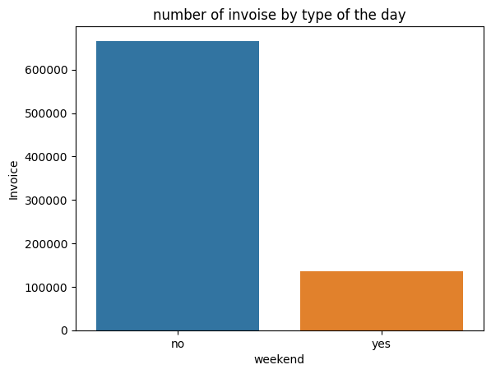
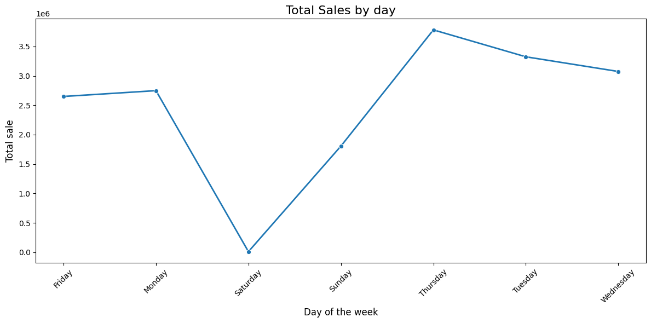
EDA
Top 5 Invoice

Slide 8
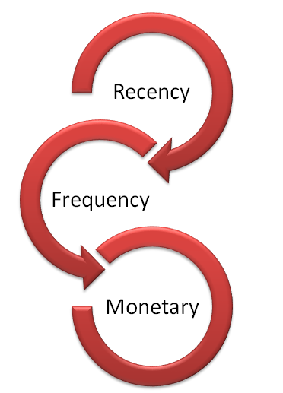
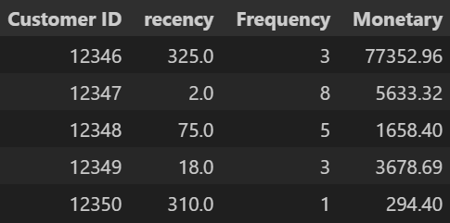
RFM(Recency, Frequency, Monetary) Analysis:
RFM analysis, or RFM stands for recency, frequency, and monetary value, is a marketing technique that uses data about customer behavior to segment customers and prioritize them. It's commonly used in direct marketing and database marketing, and has received particular attention in the retail and professional services industries.
Recency: The freshness of the customer activity, be it purchases.
Frequency: The frequency of the customer transactions.
Monetary: The intention of customer to spend or purchasing power of customers.

Slide 9
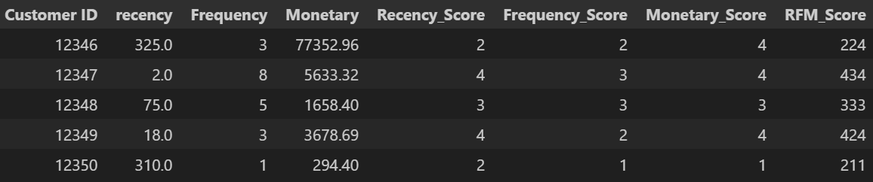
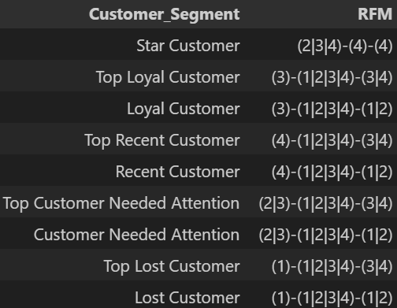
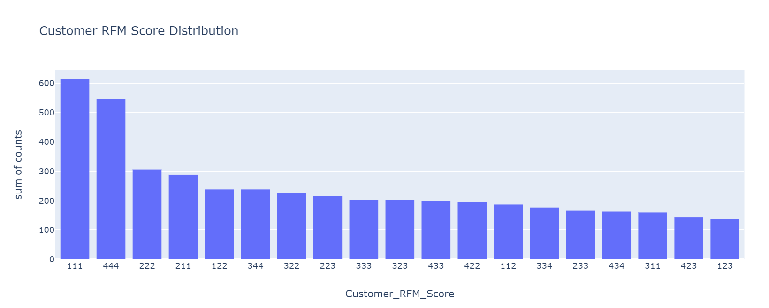
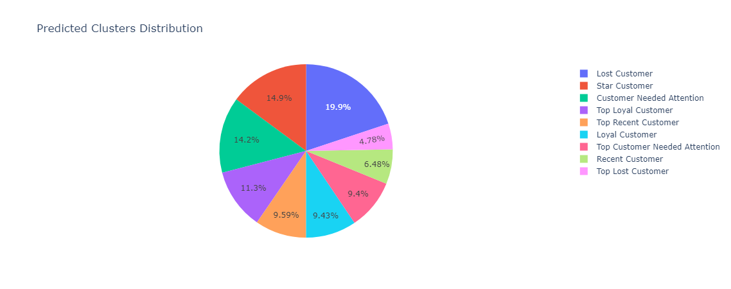
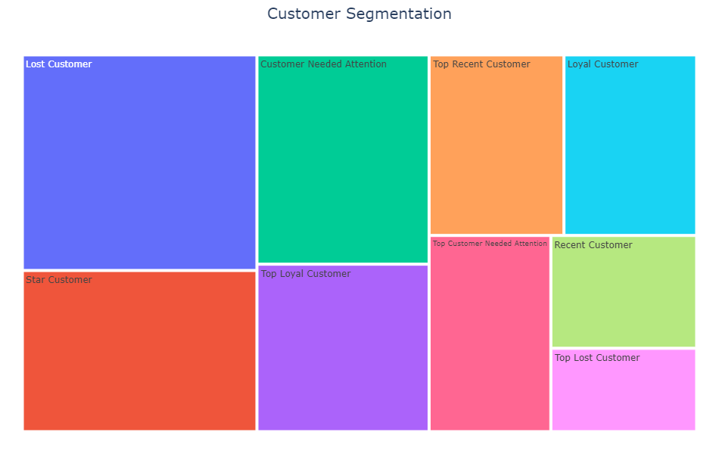
Segmentation using RFM score

Slide 10
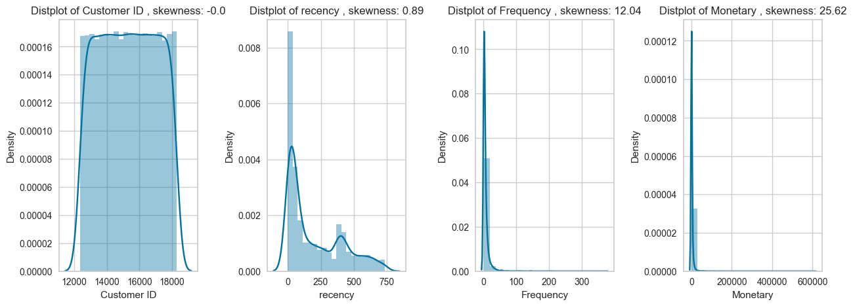
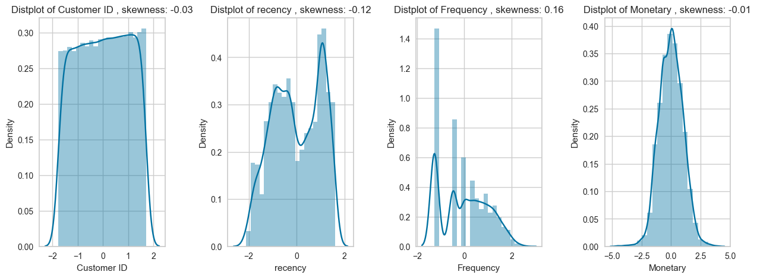
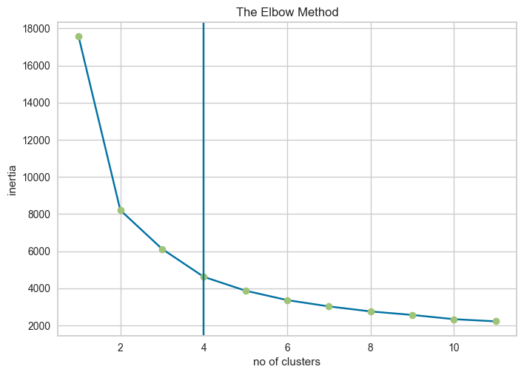
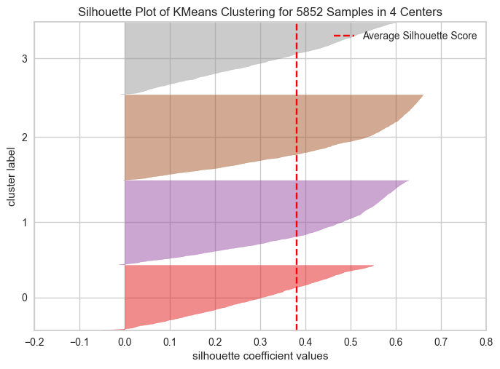
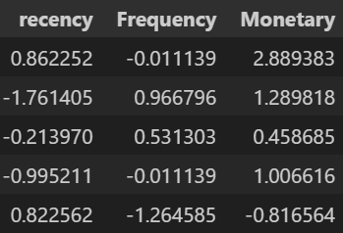
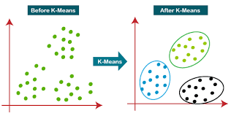
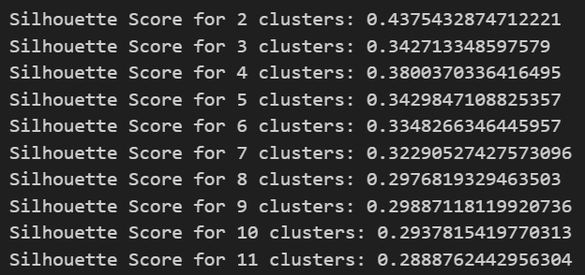

K-Means Clustering
DATA
Transformation
Apt K value
Scaling
Cluster formation
Model fitting

Slide 11
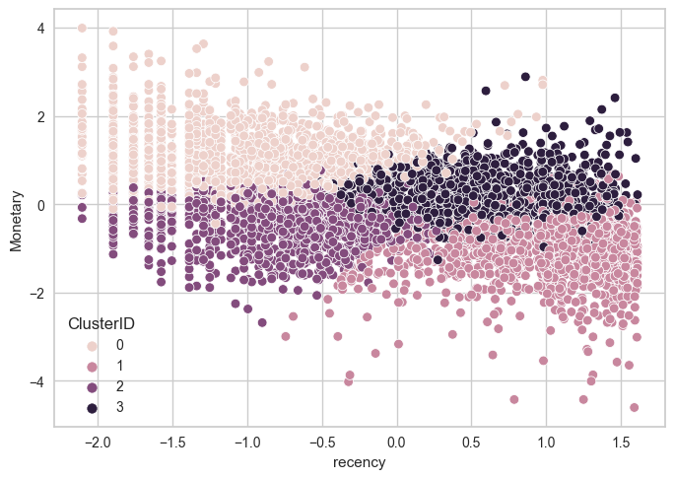
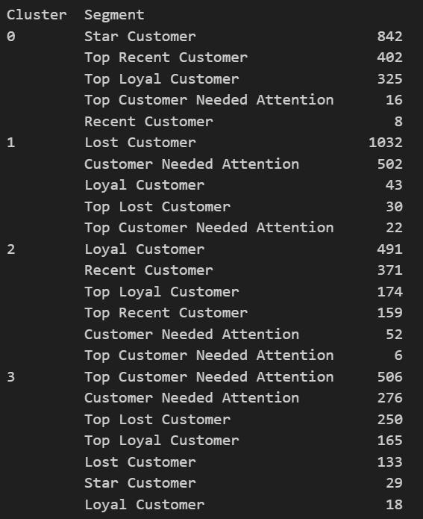
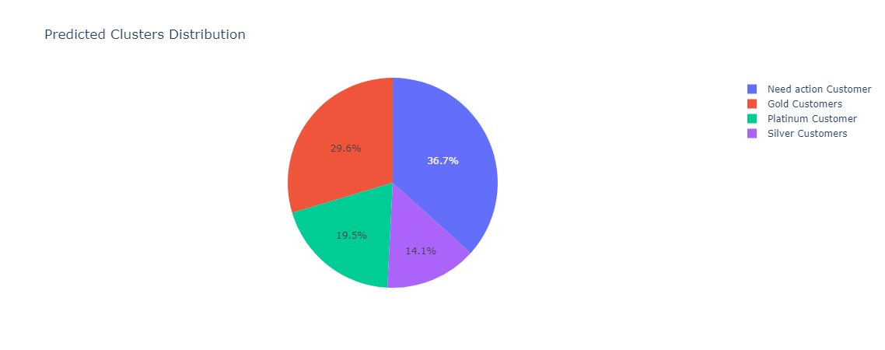
K-Means Clustering
Cluster Visualization
Labelling based on clusters & segments

Slide 12
Conclusion
Three different types of analysis were performed(EDA, RFM & K-means clustering).
All three analysis methods offer some specific advantages and also have limitations.
First RMF analysis is used to segment the customers based on their behaviour, this segments are used to label the clusters formed.
From the clusters formed, we can relate it with the various demographics like geographic location, time of purchase, type of purchase and more to drive more insights.
Note: we’ve tried DB-scan for clustering, but we got better results with K-Means clustering.

Slide 13
Thanks!

